Slide 1

Unicorn Companies Project
Langelihle Dube July DAF

Slide 2
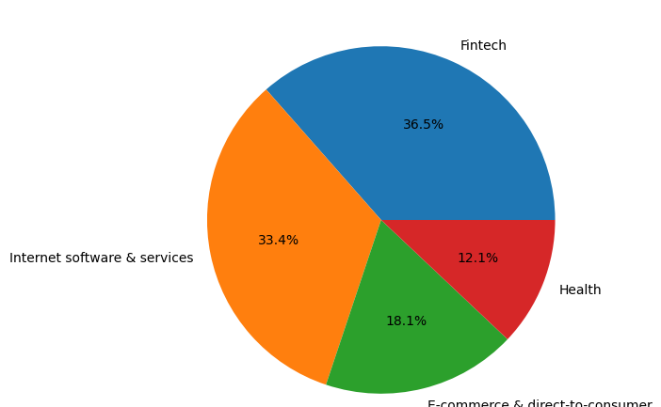
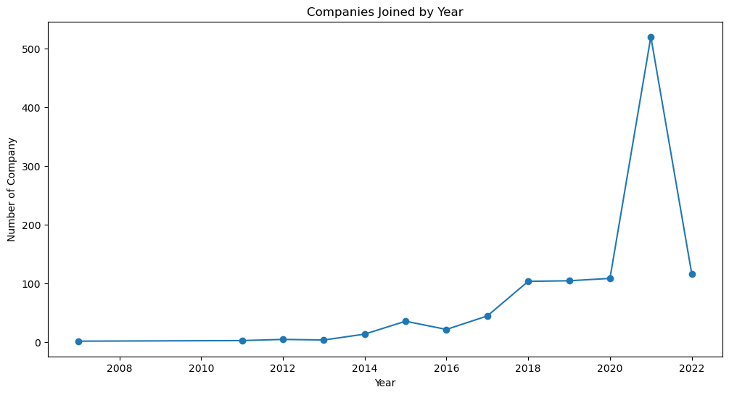
Overview of the Unicorn Companies
Unicorn companies have shown varied growth over the years with a static move prior to the year 2012 followed by gentle rises and falls till 2016. After these moves, sharp inclines are observed with the most rapid joining happening between 2020 and 2021 with an increase of over 500 new companies.
Fintech industries are dominant at unicorn companies with 36.5% market share followed by the internet and software services at 33.4% and lastly E-commerce & direct-to-consumer with 18.1% and 12.1% respectively.
The mean year of joining the Unicorn companies is 2012, 25 percentile sat at 2011, 2014 on 50 percentile and subsequently 2016 on the 75 percentile. The first unicorn company was founded in 1919 followed by trickling singular industry entrants for a few decades before growth, saturation and decline.
North America, Asia and Europe had 589, 310 and 143 respectively regarding investments with the United States (562) and China (173) leading the pack having industry and investment dominance ..

Slide 3
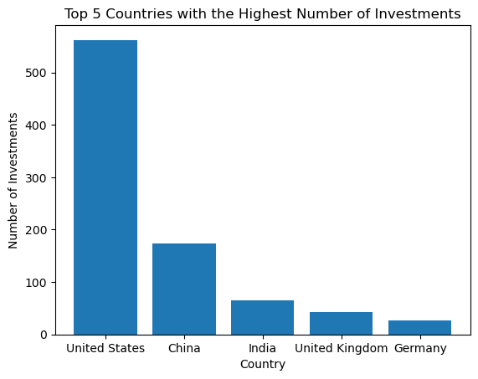
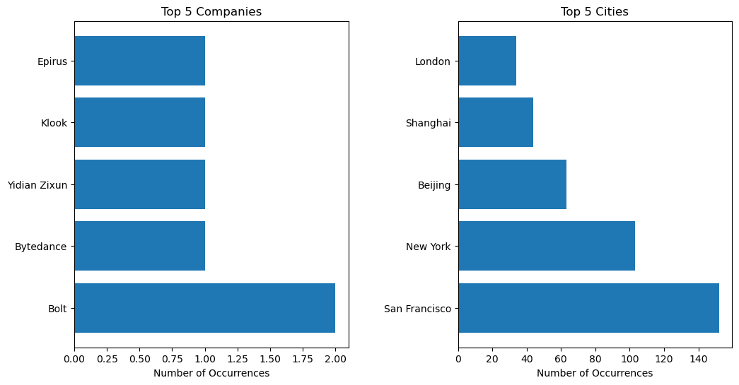
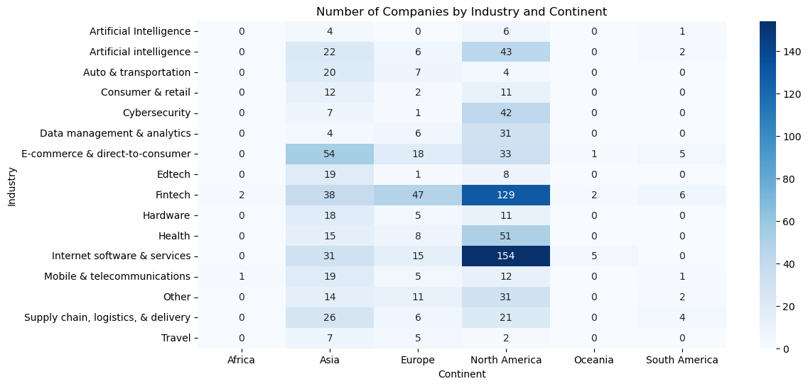
Industry Hubs
The United States of America is the industries hub with the highest concentration of companies in San Francisco and New York in the Bolt business. China trails behind USA with two city hubs, (Beijing and Shanghai) and less than half the investments in comparison.
The European market pales in comparison coming right after India.
Internet software and services Fintech companies have the largest investments in the Northen American continent totaling 283 startups.
The African market remains untapped by many industries with Fintech and mobile and telecommunications having broken through into the market.

Slide 4
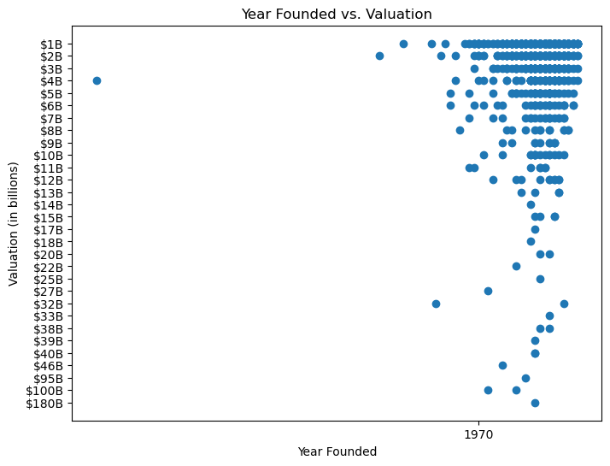
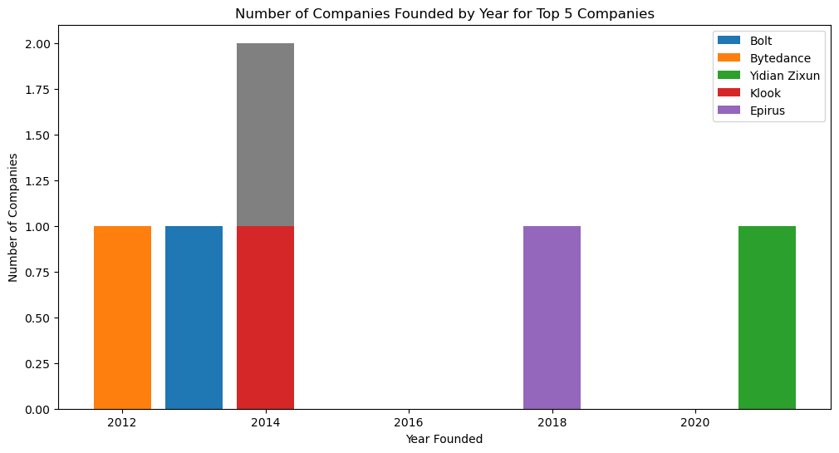
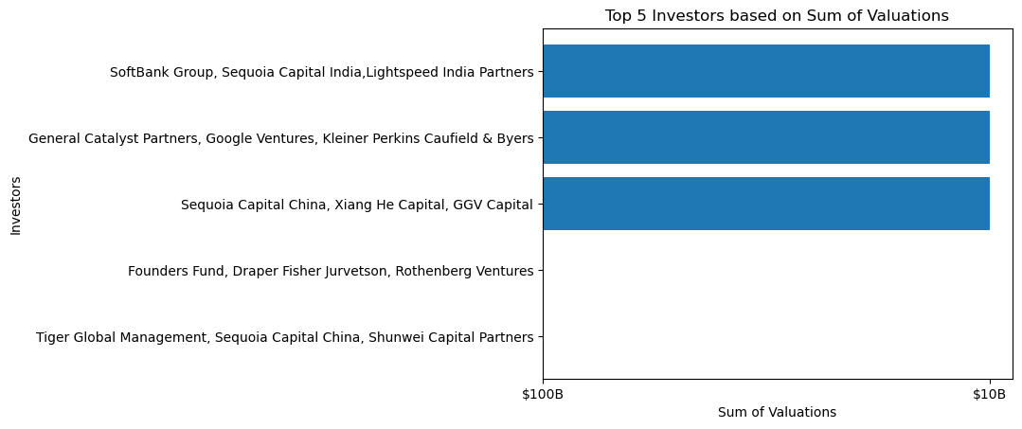
Valuation
The valuation of companies is concentrated around the $12B mark and below for startups beyond 1970.
The top investors are Indian, American and Chinese which is true based on the dominance of unicorn companies in these countries.
Artificial intelligence has been noted to rank the highest in terms of evaluation yet one of the most recent inceptions.
1058 unique invesors was derived from the descriptive results.

Slide 5
Recommendations
Research and development has become the backbone of industry growth and success hence unicorn companies need to expend more into this organisational side to remain relevant while engaging into market leadership positions to drive business direction.
Creation of adaptive business models as technology brings about small quality gaps and empowered consumers who are difficult to tame. Strategic marketing especially taking advantage of social media platforms will be a direct approach of entering less dominated markets. Unicorn companies should focus on the untapped and emergent markets for growth and expansion while developing strategic teams which are vital to business success.
Strategic partnerships will be a prerequisite for market penetration; hence, unicorn companies need to be emphatic in these value chain selections to ensure they preserve their names and investor confidence.
Brand building is essential part of survival and should be emphasized throughout various stages for customer satisfaction.

